Slide 1

Queensland Orthopaedic Research Fund

Slide 2

Declaration of Interest
I declare that in the past three years I have:
held shares in: nil
received royalties from: nil
done consulting work for: nil
given paid presentations for: nil
received institutional support from: nil
Signed: Peter Steadman

Slide 3

Background
ACNC compliance
Tax deductible status
Engaged NFP specialist advisor-community business Australia with well credentialled background
Strategic Plan and Fundraising Action Plan
BDO accountants- compliance BAS statutory req- pro bono
Director’s Liability Insurance – AOA
Academic Committee selected, ToR set
Application pathway, criteria and timeframes established (Applications open in February and August each year)
Queensland branch AOA engagement- this is the members charity built for our professional community
Website –– Password for AOA Members: QORF4Members
qorf.com.au

Slide 4
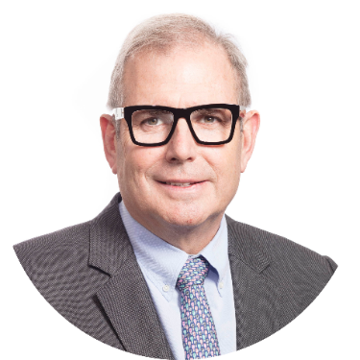
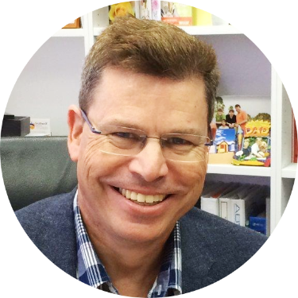
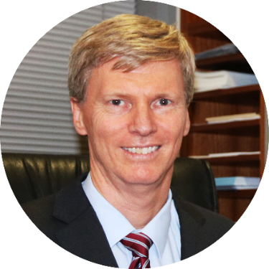
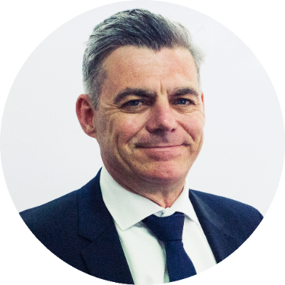
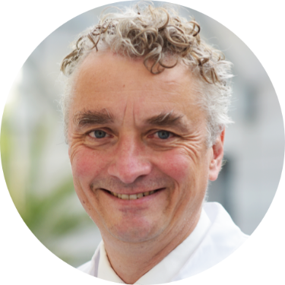
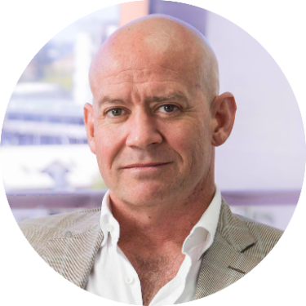
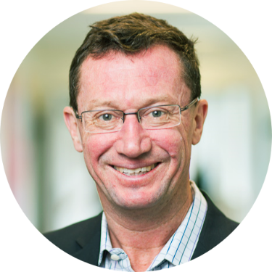
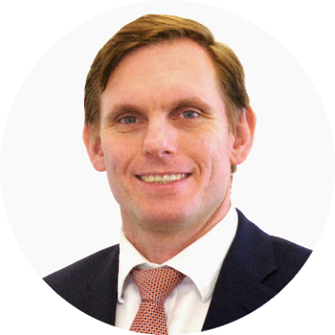
Board
Who we are
Academic Committee
Peter Steadman Greg Couzens Philip Dalton
Christopher Vertullo Michael Schuetz Kenneth Cutbush Ross Crawford Timothy McMeniman

Slide 5
What we’ve done
(past 10 months)
1 x grant round completed (2nd round in process)
Financial Planning – Administration costs now 100% covered by the AOA Queensland Branch - QORF resources protected
Strategic Planning – engaged Adrian Cosenza
survey in progress - strategy workshop 16 October

Slide 6
Financial Report
ATO compliant
Profit and loss
Queensland Research Foundation Institute

Slide 7

Projects Supported 2021
Presentations to follow
The cost-effectiveness of arthroplasty clinics. When should we discharge patients?
Ahmed Mahmoud
Topical antibiotics in ankle fracture surgery (TAAFS) study
Grant Menegon
Antibiotic coated rods: a 15-year experience of Indications, Surgical Techniques and Clinical Outcomes
Andrew Foster
Effectiveness of Telehealth reviews of non-urgent orthopaedic patients during the COVID-19 pandemic
Mashrur Hossain

Slide 8
How to apply for a Grant
Apply via QORF website
Key dates for 2021
Grant Round 2
1 August: Grant applications open
30 September: Part A due
October: Academic Committee assess grant applications; provide feedback
18 November: Part B due/final closing date
Late November: Academic Committee rank applications and meet with Board to establish successful applicants and grant amounts
Mid January: Successful/unsuccessful grant applicants notified
qorf.com.au
Must be a PHO or Trainee
Advertise through QDOGs, QHealth & AOA
2 step application process – allows for mentoring opportunity

Slide 9
Grant comes with some compliance rules and participation caveats

Slide 10
What we’re working on
Strategic Plan – in progress
Academic and fundraising event – “Supporting researchers at every stage”
Industry Engagement – partnership packages being finalised
Remain and continue to develop financial independence
Expanding application criteria to offer grants to AOA consultants
Mentoring program – to be developed further
Potential to partner with REDCap (Research Electronic Data Capture) as a resource for applicants

Slide 11
Strategic Planning - Emerging Themes
Key Stakeholders
Orthopaedic community – both AOA membership and within the Healthcare sector
University sector
Industry – financial support essential
Other research foundations
Prevention programs
General public
Challenges
Financial support/sustainability
Recognition/Awareness
Ensuring a high standard of relevant, meaningful research
Meeting ever increasing demands of reporting, ethics and data security
Opportunities and initiatives
Increase funding and therefore deliverables – scope, profile and quality of research
Support and education for PHOs, trainees and early career researchers – Link with Training Committee and QDOG
Partner with existing research programs, foundations and universities
Increase awareness and establish QORF as a lead source of funding of orthopaedic research in Queensland
Ensure equitable access regardless of geographical location
Publication costs covered – could this be considered

Slide 12
Support QORF
Provide feedback for Strategic Plan - survey
How to donate – AOA membership form, website (PayPal or direct deposit)
Support research mentoring program – contact email admin@qorf.com.au or via website
Stay tuned for News and Event invitations

Slide 13
Thank you
Cindy and David Parker
BDO Accountants
AOA Queensland Branch and AOA Federal
The Academic Committee
Donors

Slide 14
Thank you
Total Donations $16,700

Slide 15
Thank you all local donors
> $999
Richard Gibberd
> $300
David Ness
> $100
Francis Connon, Scott Crawford, David Bade, Benjamin Beer, Christopher Bell, Russell Bourne, James Brown, Rohan Brunello, Kim Bulwinkel, Lorenzo Calabro, Andrew Mayo, Timothy McMeniman, Chris Morrey, Angus Moxon, Tendai Mwaturura, Peter Myers, Dion Noovao, William O'Callaghan, Ben Parkinson, Jeffery Peereboom, Paul Pincus, Robert Pozzi, Ross Crawford, Nicholas Croker, Philip Dalton, Peter Darcy, Cameron Downes, Gauguin Gamboa, Michael Holt, David Liu, Varaguna Manoharan, Raymond Randle, Edward Reye, John Roe, John Scott, Jon Smith, Adriaan Smith, Annabelle Stabler, Peter Steadman, Danielle Wadley, Chris Wainwright, Malcolm Wallace, John Walsh, Anthony Wilson, Leo Zeller

Slide 16

Questions onward and upward

